Slide 1
Follow Along
*Start server

Slide 2
Introduction to D3.js
By Alex Rogers

Slide 3
What is D3.js
Wikipedia Says:
“D3.js (or just D3 for Data-Driven Documents) is a JavaScript library for producing dynamic, interactive data visualizations in web browsers. It makes use of the widely implemented SVG, HTML5, and CSS standards. It is the successor to the earlier Protovis framework. In contrast to many other libraries, D3.js allows great control over the final visual result. Its development was noted in 2011, as version 2.0.0 was released in August 2011.”
Used to manipulate documents based on data, and create visual representations of that data
https://medium.freecodecamp.org/learn-d3-js-in-5-minutes-c5ec29fb0725

Slide 4
D3.js Features
Flexibility
Since D3 relies on DOM manipulation instead of pre-built graphs, it allows for a lot of freedom and creation
Compatibility
It can be added to other JS Frameworks without disrupting them. It is also lightweight and runs smoothly, even with big data.
Serverless
D3 does not depend on a front-end or back-end server
https://www.quora.com/What-are-some-of-the-best-features-of-D3-js#
https://towardsdatascience.com/interactive-data-visualization-with-d3-js-43fc3428a27e

Slide 5
FAQ
Can you drill down in D3.js?
Yes, but…
Excellent example: Drill-Down Pie Chart using D3
D3-based libraries such as DC.js provide less work upfront with drill-down
Does it integrate with other libraries and frameworks?
Of course!
React, Angular, TypeScript…anything JS-based
What type of data do you need for D3?
Works for several types. Static, JSON, CSV, XML, etc…
https://codepen.io/ademps/pen/mlHyC
https://dc-js.github.io/dc.js/
https://towardsdatascience.com/interactive-data-visualization-with-d3-js-43fc3428a27e

Slide 6
More than a chart library
DOM Manipulation
Using data binding and text() to manipulate DOM
In d3, you select the element before it’s created
SVG-based data visualization
Using data binding, arrays, and enter() to make charts
https://medium.freecodecamp.org/learn-d3-js-in-5-minutes-c5ec29fb0725

Slide 7

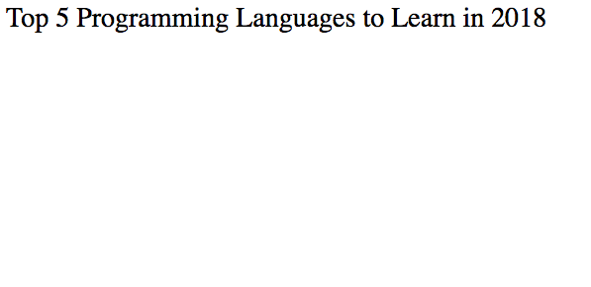
DOM Manipulation example
Starting out with an empty ordered list

Slide 8
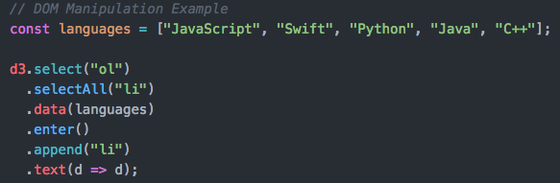
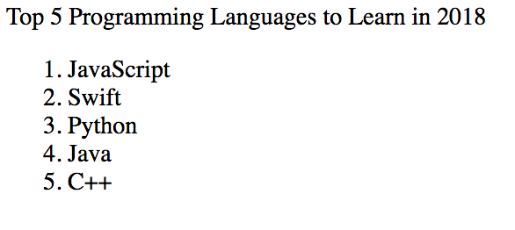
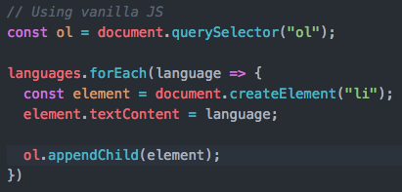
DOM Manipulation Example
Populating list with <li> tags using D3

Slide 9






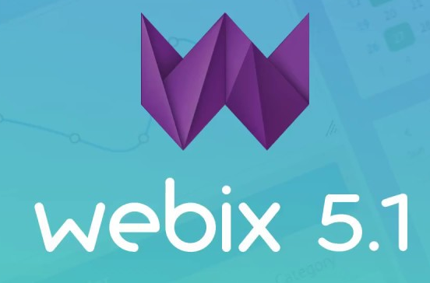

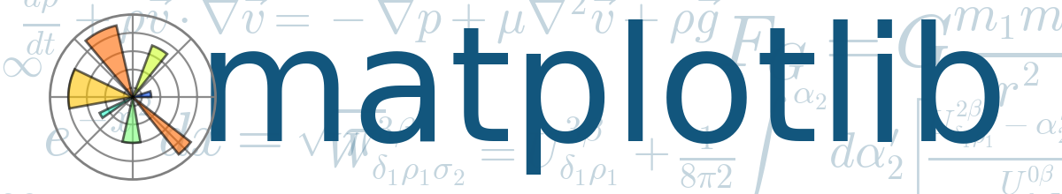




Competitors of D3
Chart libraries built from D3
https://www.slant.co/options/10577/alternatives/~d3-js-alternatives
https://www.fastcompany.com/3029760/the-five-best-libraries-for-building-data-vizualizations
https://thenextweb.com/dd/2015/06/12/20-best-javascript-chart-libraries/

Slide 10



Who already uses D3?
https://www.sitepoint.com/15-best-javascript-charting-libraries/

Slide 11
Who should use d3?
Those who love lots of control over their graphs will like D3
Those who need a quick graph generated for them may have to get used to D3

Slide 12
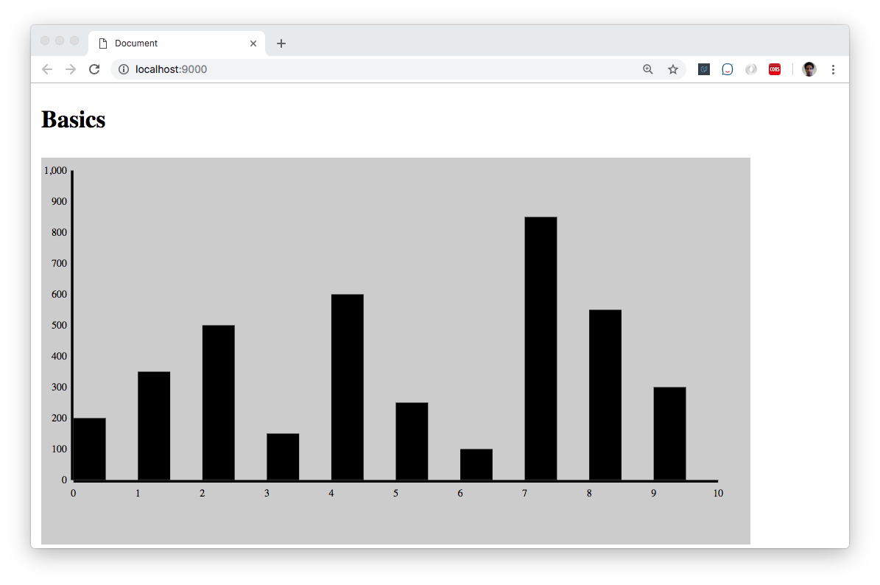
Examples of D3 (Beginner Level)
Simple, static bar graph made in D3

Slide 13
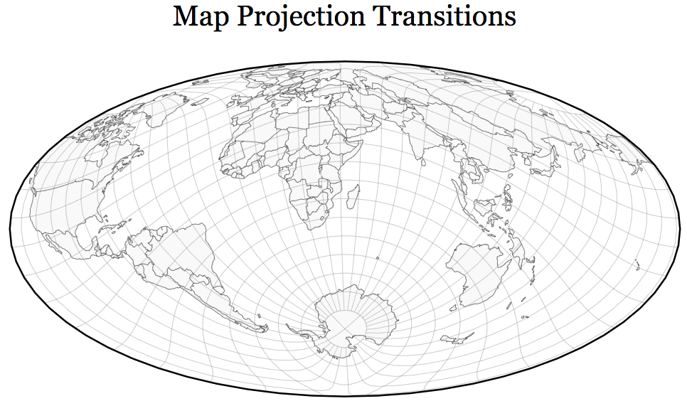
Examples of D3 (Advanced)
Advanced Example- Map Projection:
https://www.jasondavies.com/maps/transition/

Slide 14
Basics: Bar Graph Overview
Set up space for data-visualization chart
Layer an X-axis and Y-axis
Bind data to be able to reference in setup
Set svg attributes to align with shape for graph

Slide 15
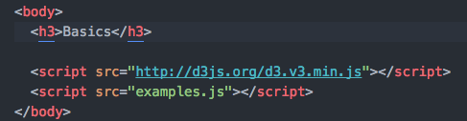
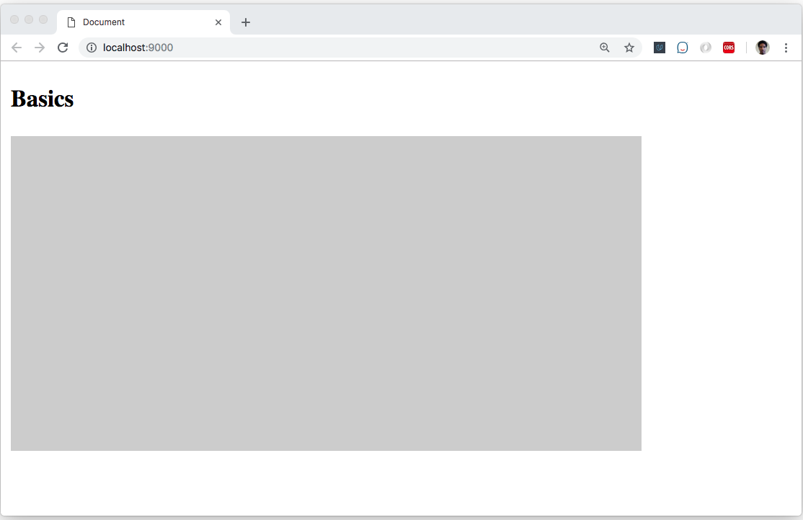

Basics: Creating an svg canvas
Start by selecting parent element, then adding an svg element with append()
Then, set width and height

Slide 16
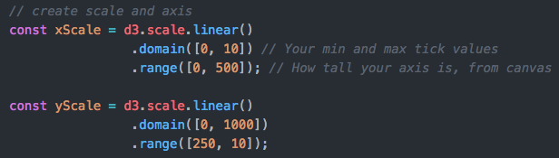
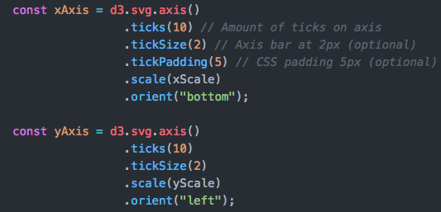
Basics: Making an axis
Create scales that the axis can reference (and the attributes later on)

Slide 17
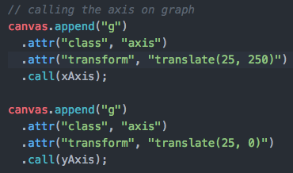
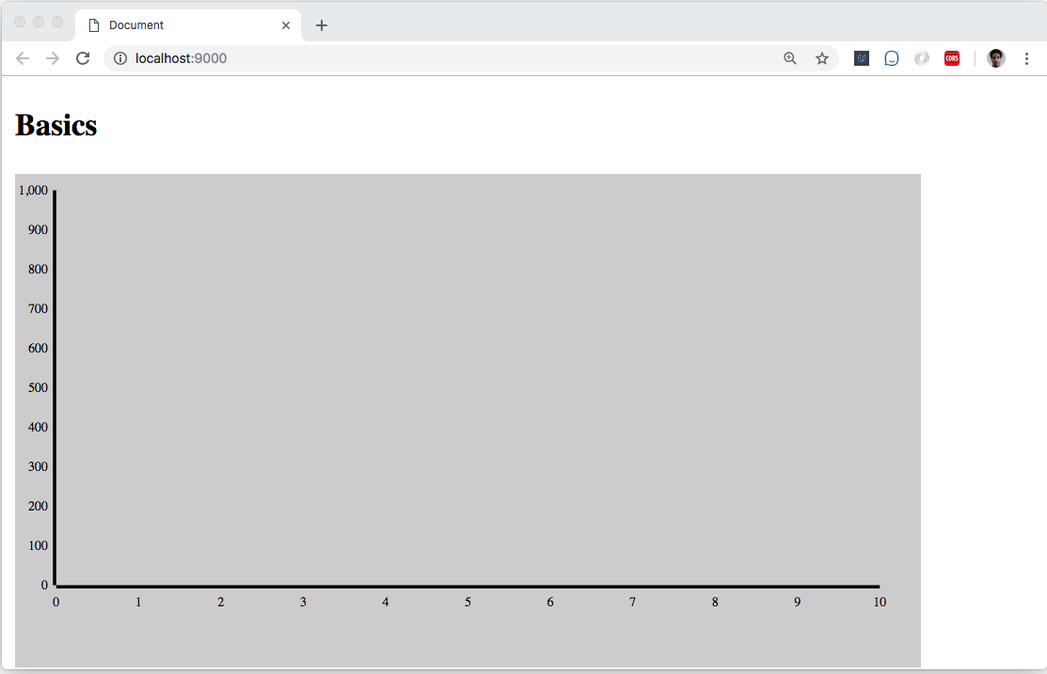
Basics: Making an axis
Call the axis’ by adding a general “g” element (most common). Use CSS transform to get the axis in view.

Slide 18
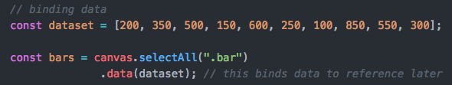
Basics: Binding Data
Data() will bind an array of data, allowing for shapes to be created using the given array.
selectAll() will bind the data to all elements with the class of “bar” (before we have created the class itself)

Slide 19
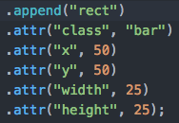

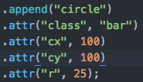

Basics: Using svg Rules to Create Shapes I.
Attributes of shape
Resulting shape

Slide 20
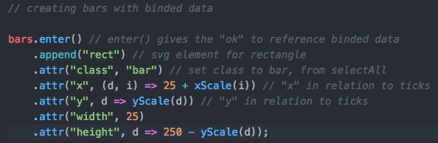
Basics: Using svg Rules to Create Shapes II.
SVG elements with binded data to iterate shapes
Here we set the class “bar” to every rect we want to use (from earlier)
Binded data can now be referenced in attr using callback function (variable d), and iterated (variable i)
Also using scales to align with axis and stay within the domain

Slide 21
Basics: Using svg Rules to Create Shapes II.

Slide 22
Advantages vs. Disadvantages of d3
Advantages
Disadvantages
Lots of freedom and control
Seamless integration with other frameworks
Handles data lightly
No built-in graphs
ETL is more manual

Slide 23
Resources
https://d3js.org/
https://square.github.io/intro-to-d3/
https://davidwalsh.name/learning-d3
https://d3indepth.com/

Slide 24
Follow Me
https://www.linkedin.com/in/alexrogers823
https://github.com/alexrogers823
Alex.rogers823@gmail.com

Slide 25
Lets Make a Cooler Bar Graph
Open index.html in cloned repository
Work in the barGraph-START.js file
Reference these slides to get graph up and running

